Slide 1
The “Good Enough” Theory
Software Engineering
Neil Toporski

Slide 3
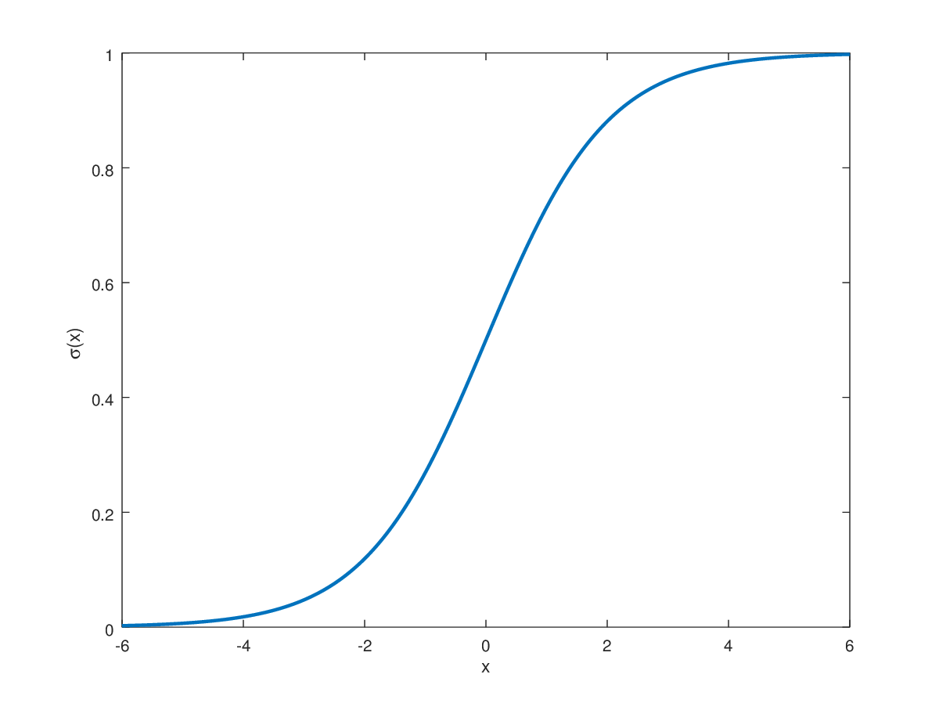
Good Enough Theory
Result
Effort

